Slide 1
CS 295A/395D: Artificial Intelligence
More on Markov Chains
& Intro to MDPs
Prof. Emma Tosch
22 April 2022

Slide 2
Logistics
Worksheet due Wednesday
Discussion about final topics in the class & final in-class exam
Do this at the end of class

Slide 3
Agenda
Review: Markov Chains
Markov Decision Processes (MDPs)
Partially Observed Markov Decision Processes (POMDPs)

Slide 4
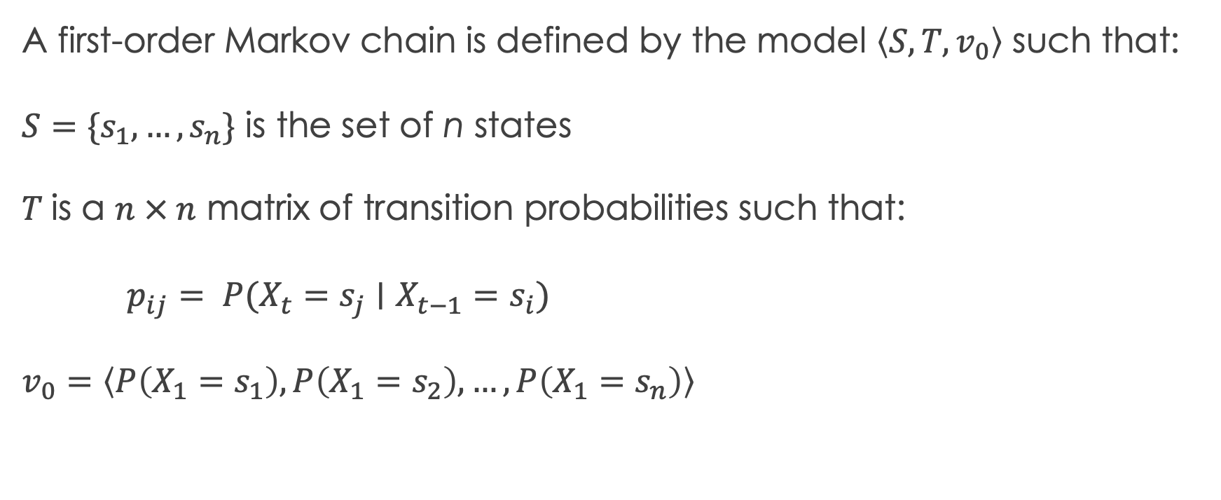
Review: Markov Chains
A first-order Markov chain is defined by the model $\left\langle S, T, v_{0}\right\rangle$ such that:
$S=\{s_{1},…, s_{n}\}$ is the set of n states
$T$is a $n × n$ matrix of transition probabilities such that:
$p_{ij}= P(X_{t}=s_{j}∣X_{t−1}=s_{i})$
$v_{0}=\left\langle P\left(X_{1}=s_{1}\right), P\left(X_{1}=s_{2}\right), …, P\left(X_{1}=s_{n}\right)\right\rangle$

Slide 5
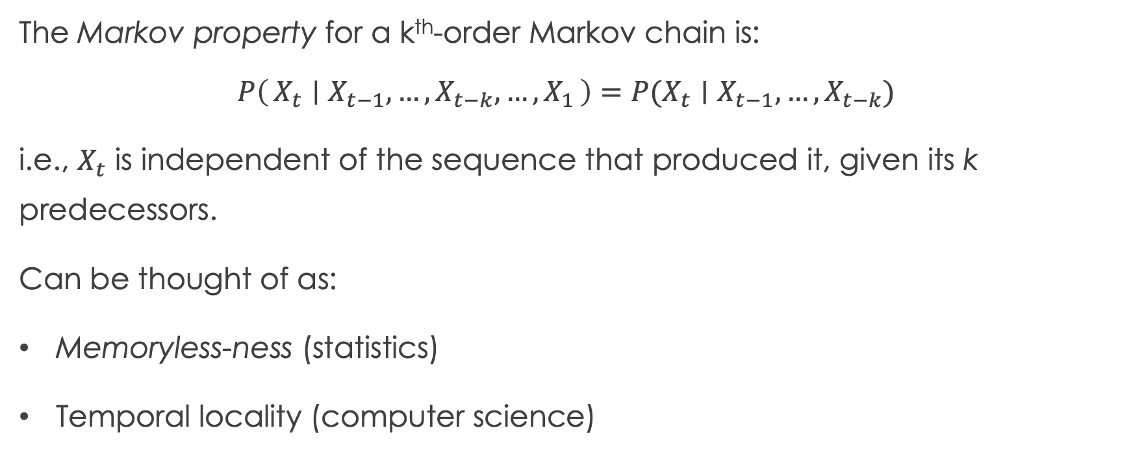
Review: Markov Property
The Markov property for a k^{th}-order Markov chain is:
$$P\left(X_{t} ∣ X_{t−1}, …, X_{t−k},…, X_{1}\right)=P(X_{t}∣X_{t−1}, …,X_{t−k})$$
i.e., $X_{t}$ is independent of the sequence that produced it, given its k predecessors.
Can be thought of as:
Memoryless-ness (statistics)
Temporal locality (computer science)

Slide 6
Review: Graphical representation vs. Bayes Nets
Bayes Net
Encodes independence relations
Nodes represent conditional probability distributions
State transition diagram
Encodes transition probabilities
Nodes encode conditional probability distributions
Markov Chain
Represents the sequence of states
Encodes independence relations
B
E
A
F
L
Bayes Net

Slide 7
Review: Graphical representation vs. Bayes Nets
Bayes Net
Encodes independence relations
Nodes represent conditional probability distributions
State transition diagram
Encodes transition probabilities
Nodes encode conditional probability distributions
Markov Chain
Represents the sequence of states
Encodes independence relations
B
E
State transition diagram
0
1
2
3
A
F
L
Bayes Net

Slide 8
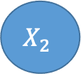
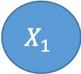
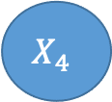
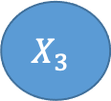
Review: Graphical representation vs. Bayes Nets
Bayes Net
Encodes independence relations
Nodes represent conditional probability distributions
State transition diagram
Encodes transition probabilities
Nodes encode conditional probability distributions
Markov Chain
Represents the sequence of states
Encodes independence relations
B
E
State transition diagram
0
1
2
3
A
F
L
$$X_{1}$$
$$X_{2}$$
$$X_{3}$$
$$X_{4}$$
Markov chain
Bayes Net

Slide 9
k^{th}-order Markov Chain
State transition diagram
Specifically, a first order Markov chain (i.e., k=1)
0
1
2
3
$$X_{1}$$
$$X_{2}$$
$$X_{3}$$
$$X_{4}$$
Markov chain

Slide 10
k^{th}-order Markov Chain
State transition diagram
What might a 2nd order (k=2) Markov chain look like?
0
1
2
3
$$X_{1}$$
$$X_{2}$$
$$X_{3}$$
$$X_{4}$$
Markov chain

Slide 11
k^{th}-order Markov Chain
State transition diagram
Graphically, add back edges to the chain
0
1
2
3
$$X_{1}$$
$$X_{2}$$
$$X_{3}$$
$$X_{4}$$
Markov chain

Slide 12
k^{th}-order Markov Chain
State transition diagram
What about the state transition diagram?
0
1
2
3
$$X_{1}$$
$$X_{2}$$
$$X_{3}$$
$$X_{4}$$
Markov chain

Slide 13
k^{th}-order Markov Chain
State transition diagram
0
1
2
3
What about the state transition diagram?

Slide 14
k^{th}-order Markov Chain
00
01
02
03
What about the state transition diagram?
10
11
12
13
20
21
22
23
30
31
32
33

Slide 15
k^{th}-order Markov Chain
00
01
What about the state transition diagram?
10
11
12
13
20
21
22
23
30
31
32
33

Slide 16
k^{th}-order Markov Chain
00
01
What about the state transition diagram?
10
11
12
21
22
23
32
33

Slide 17
k^{th}-order Markov Chain
00
01
What about the state transition diagram?
10
11
12
21
22
23
32
33

Slide 18
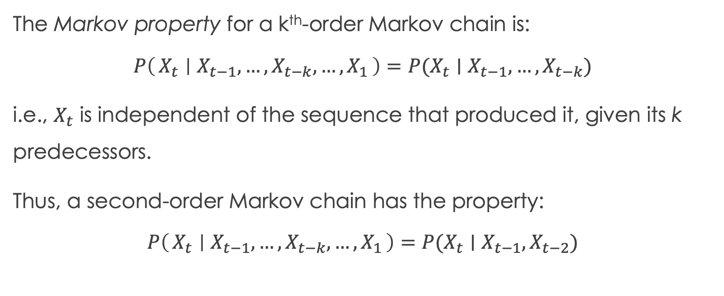
Recall: Markov Property
The Markov property for a k^{th}-order Markov chain is:
$$P\left(X_{t} ∣ X_{t−1}, …, X_{t−k},…, X_{1}\right)=P(X_{t}∣X_{t−1}, …,X_{t−k})$$
i.e., $X_{t}$ is independent of the sequence that produced it, given its k predecessors.
Thus, a second-order Markov chain has the property:
$$P\left(X_{t} ∣ X_{t−1}, …, X_{t−k},…, X_{1}\right)=P(X_{t}∣X_{t−1},X_{t−2})$$

Slide 19
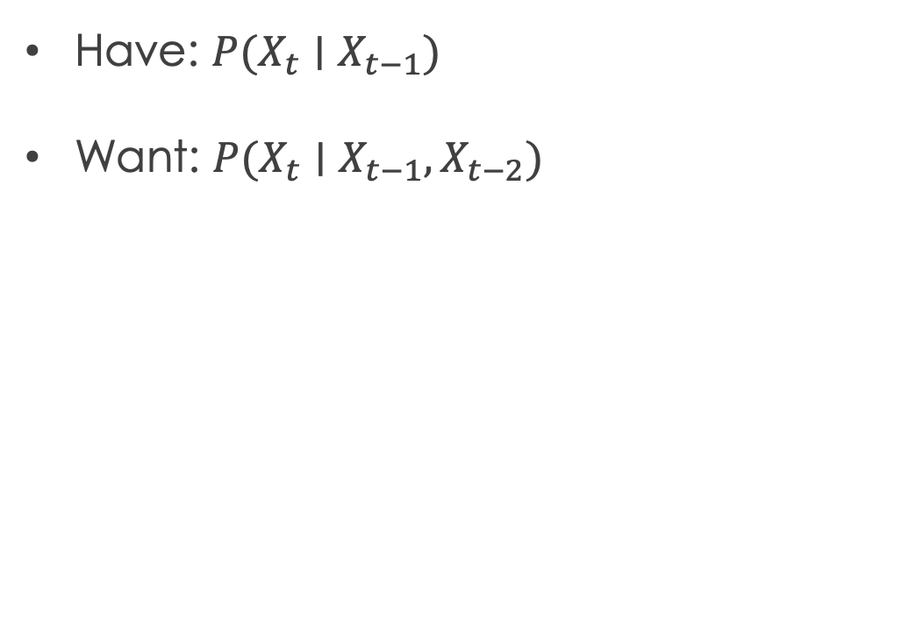
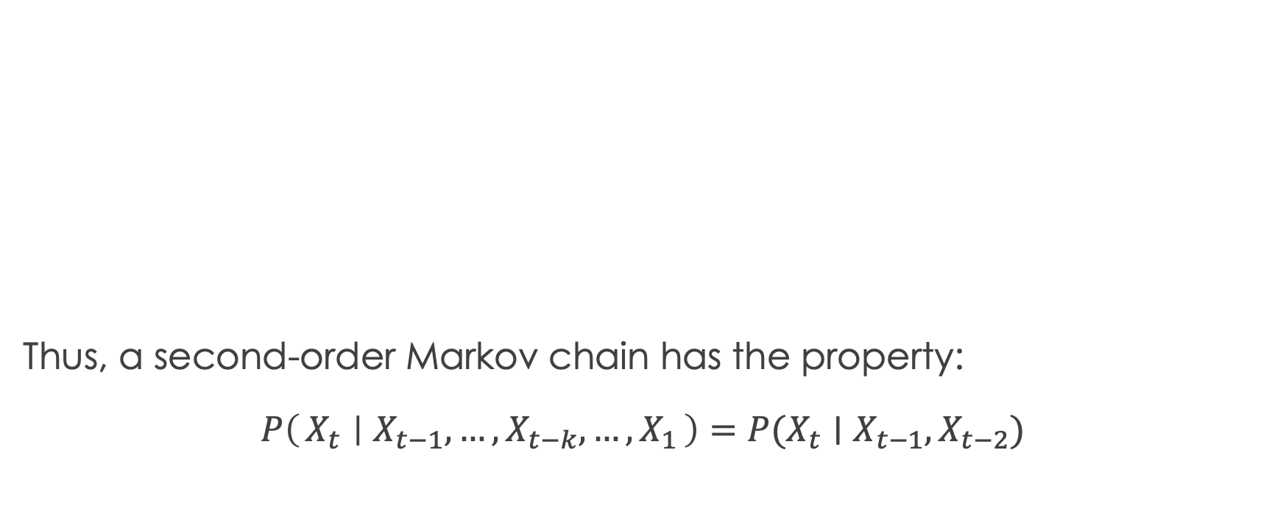
Can we get these probabilities from our original transition diagram?
The Markov property for a k^{th}-order Markov chain is:
$$P\left(X_{t} ∣ X_{t−1}, …, X_{t−k},…, X_{1}\right)=P(X_{t}∣X_{t−1}, …,X_{t−k})$$
i.e., $X_{t}$ is independent of the sequence that produced it, given its k predecessors.
Thus, a second-order Markov chain has the property:
$$P\left(X_{t} ∣ X_{t−1}, …, X_{t−k},…, X_{1}\right)=P(X_{t}∣X_{t−1},X_{t−2})$$
Have: $P(X_{t}∣X_{t−1})$
Want: $P(X_{t}∣X_{t−1}, X_{t−2})$
State transition diagram
0
1
2
3

Slide 20
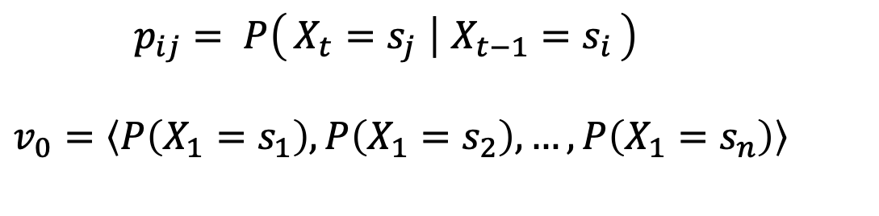
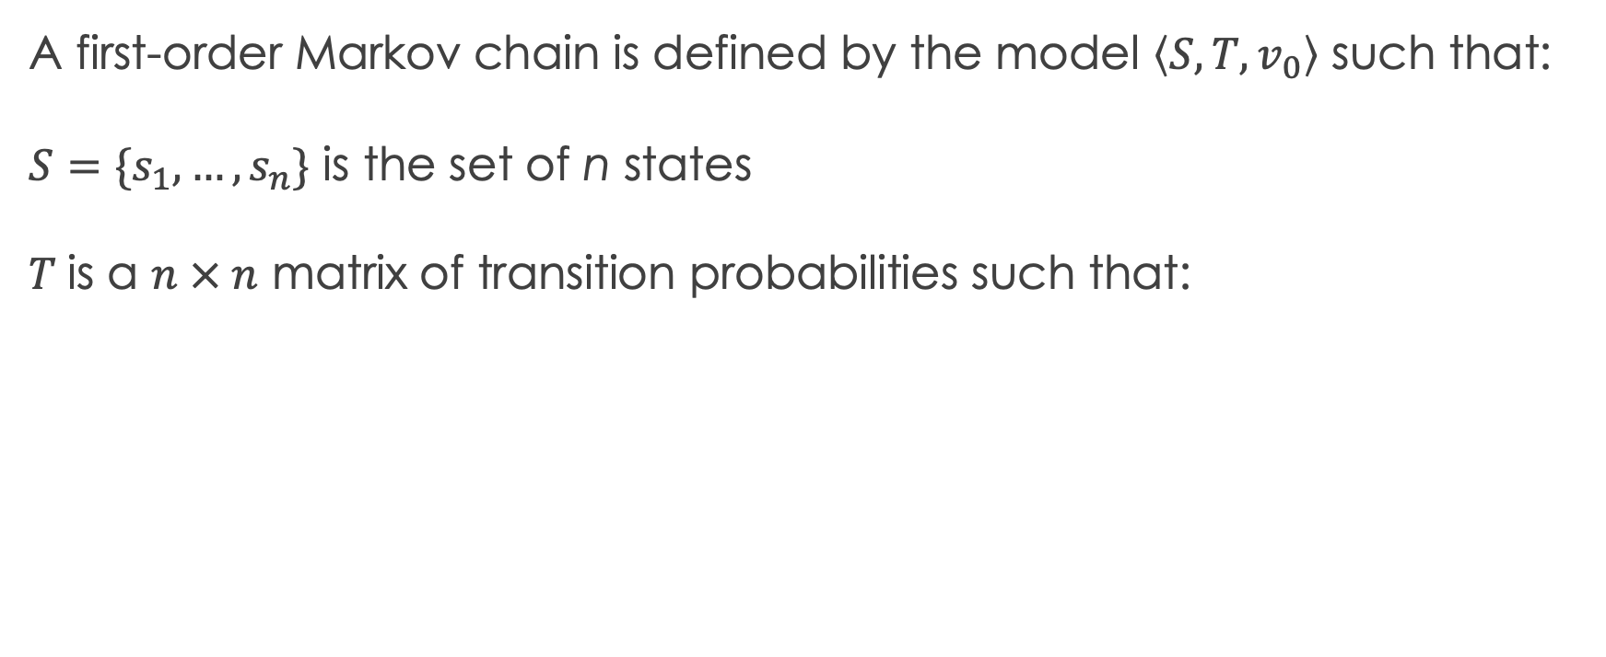
k^{th}-order Markov Chain
A first-order Markov chain is defined by the model $\left\langle S, T, v_{0}\right\rangle$ such that:
$S=\{s_{1},…, s_{n}\}$ is the set of n states
$T$is a $n × n$ matrix of transition probabilities such that:
$p_{ij}= P\left(X_{t}=s_{j} ∣ X_{t−1}=s_{i}\right)$
$v_{0}=\left\langle P\left(X_{1}=s_{1}\right), P\left(X_{1}=s_{2}\right), …, P\left(X_{1}=s_{n}\right)\right\rangle$

Slide 21
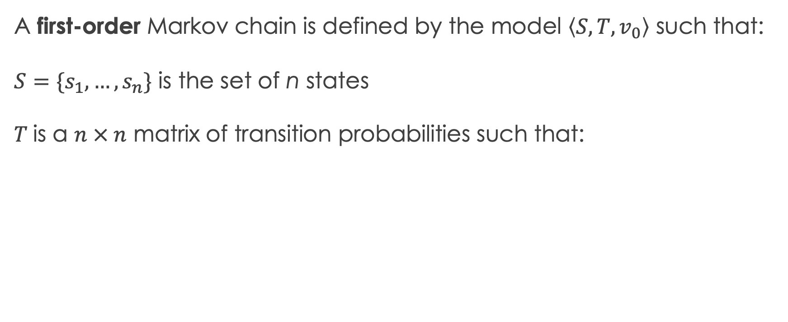
k^{th}-order Markov Chain
A first-order Markov chain is defined by the model $\left\langle S, T, v_{0}\right\rangle$ such that:
$S=\{s_{1},…, s_{n}\}$ is the set of n states
$T$is a $n × n$ matrix of transition probabilities such that:
$p_{ij}= P\left(X_{t}=s_{j} ∣ X_{t−1}=s_{i}\right)$
$v_{0}=\left\langle P\left(X_{1}=s_{1}\right), P\left(X_{1}=s_{2}\right), …, P\left(X_{1}=s_{n}\right)\right\rangle$

Slide 22

k^{th}-order Markov Chain
A k^{th}-order Markov chain is defined by the model $\left\langle S, T, v_{0}\right\rangle$ such that:
$S=\{s_{1},…, s_{n}\}$ is the set of n states
$T$is a $n × n$ matrix of transition probabilities such that:
$p_{ij}= P\left(X_{t}=s_{j} ∣ X_{t−1}=s_{i}\right)$
$v_{0}=\left\langle P\left(X_{1}=s_{1}\right), P\left(X_{1}=s_{2}\right), …, P\left(X_{1}=s_{n}\right)\right\rangle$

Slide 23
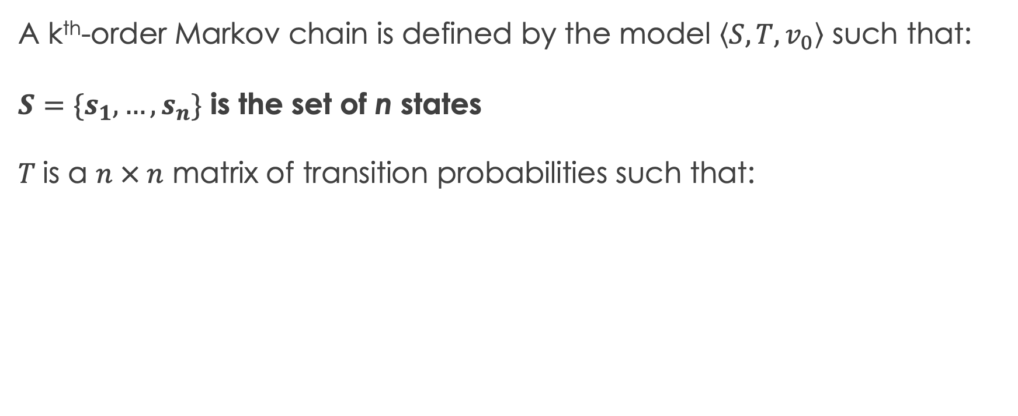
k^{th}-order Markov Chain
A k^{th}-order Markov chain is defined by the model $\left\langle S, T, v_{0}\right\rangle$ such that:
$S=\{s_{1},…, s_{n}\}$ is the set of n states
$T$is a $n × n$ matrix of transition probabilities such that:
$p_{ij}= P\left(X_{t}=s_{j} ∣ X_{t−1}=s_{i}\right)$
$v_{0}=\left\langle P\left(X_{1}=s_{1}\right), P\left(X_{1}=s_{2}\right), …, P\left(X_{1}=s_{n}\right)\right\rangle$
State set remains the same!

Slide 24
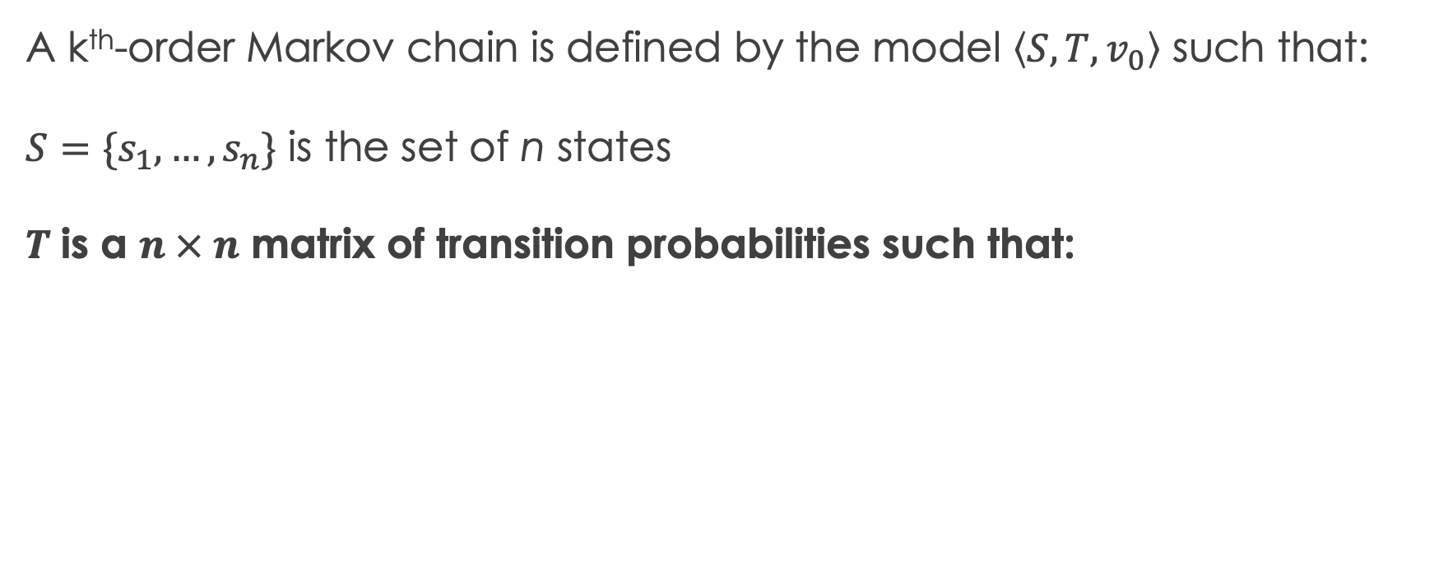
k^{th}-order Markov Chain
A k^{th}-order Markov chain is defined by the model $\left\langle S, T, v_{0}\right\rangle$ such that:
$S=\{s_{1},…, s_{n}\}$ is the set of n states
$T$is a $n × n$ matrix of transition probabilities such that:
Previously: just encoded edges
from the transition diagram as
a matrix
$p_{ij}= P\left(X_{t}=s_{j} ∣ X_{t−1}=s_{i}\right)$
$v_{0}=\left\langle P\left(X_{1}=s_{1}\right), P\left(X_{1}=s_{2}\right), …, P\left(X_{1}=s_{n}\right)\right\rangle$

Slide 25
k^{th}-order Markov Chain
A k^{th}-order Markov chain is defined by the model $\left\langle S, T, v_{0}\right\rangle$ such that:
$S=\{s_{1},…, s_{n}\}$ is the set of n states
$T$is a $n × n$ matrix of transition probabilities such that:
Recall:
s_{i} = state we are coming from
s_{j} = state we are going to
$p_{ij}= P\left(X_{t}=s_{j} ∣ X_{t−1}=s_{i}\right)$
$v_{0}=\left\langle P\left(X_{1}=s_{1}\right), P\left(X_{1}=s_{2}\right), …, P\left(X_{1}=s_{n}\right)\right\rangle$

Slide 26
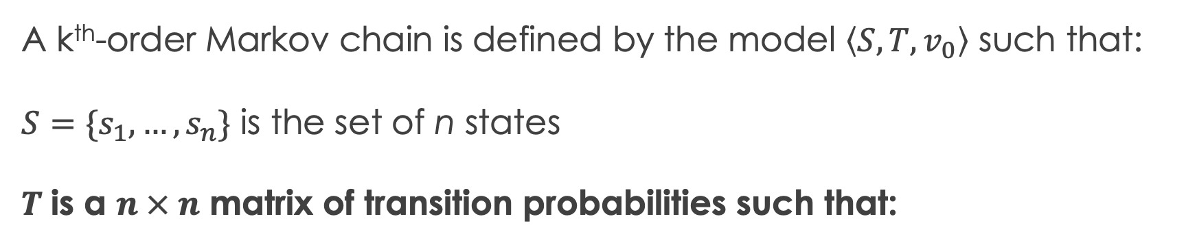
k^{th}-order Markov Chain
A k^{th}-order Markov chain is defined by the model $\left\langle S, T, v_{0}\right\rangle$ such that:
$S=\{s_{1},…, s_{n}\}$ is the set of n states
$T$is a $n × n$ matrix of transition probabilities such that:
Now: what is i?
$p_{ij}= P\left(X_{t}=s_{j} ∣ X_{t−1}=s_{i}\right)$
$v_{0}=\left\langle P\left(X_{1}=s_{1}\right), P\left(X_{1}=s_{2}\right), …, P\left(X_{1}=s_{n}\right)\right\rangle$

Slide 27
k^{th}-order Markov Chain
00
01
What about the state transition diagram?
10
11
12
21
22
23
32
33

Slide 28
k^{th}-order Markov Chain
A k^{th}-order Markov chain is defined by the model $\left\langle S, T, v_{0}\right\rangle$ such that:
$S=\{s_{1},…, s_{n}\}$ is the set of n states
$T$is a $n × n$ matrix of transition probabilities such that:
Now: what is i?
i matches a state in the
transition diagram,
not a state from S
$p_{ij}= P\left(X_{t}=s_{j} ∣ X_{t−1}=s_{i}\right)$
$v_{0}=\left\langle P\left(X_{1}=s_{1}\right), P\left(X_{1}=s_{2}\right), …, P\left(X_{1}=s_{n}\right)\right\rangle$

Slide 29
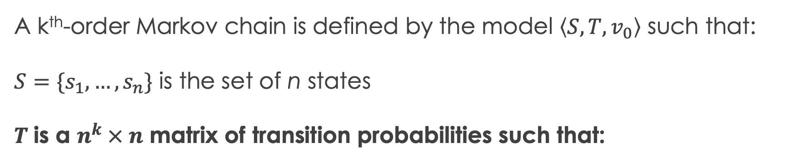
k^{th}-order Markov Chain
A k^{th}-order Markov chain is defined by the model $\left\langle S, T, v_{0}\right\rangle$ such that:
$S=\{s_{1},…, s_{n}\}$ is the set of n states
$T$is a $n^{k} × n$ matrix of transition probabilities such that:
$p_{ij}= P\left(X_{t}=s_{j} ∣ X_{t−1}=s_{i}\right)$
$v_{0}=\left\langle P\left(X_{1}=s_{1}\right), P\left(X_{1}=s_{2}\right), …, P\left(X_{1}=s_{n}\right)\right\rangle$

Slide 30
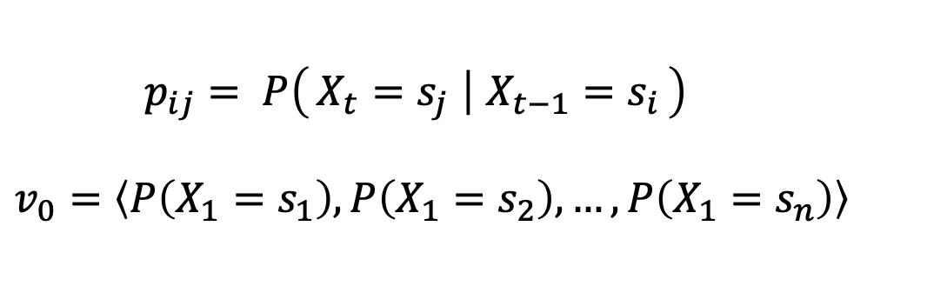
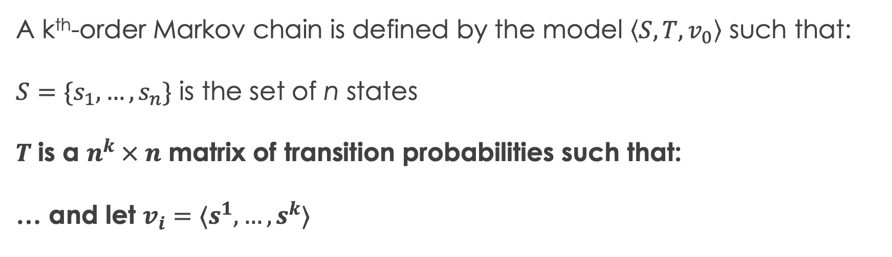
k^{th}-order Markov Chain
A k^{th}-order Markov chain is defined by the model $\left\langle S, T, v_{0}\right\rangle$ such that:
$S=\{s_{1},…, s_{n}\}$ is the set of n states
$T$is a $n^{k} × n$ matrix of transition probabilities such that:
… and let $v_{i}=⟨s^{1}, …, s^{k}⟩$
$p_{ij}= P\left(X_{t}=s_{j} ∣ X_{t−1}=s_{i}\right)$
$v_{0}=\left\langle P\left(X_{1}=s_{1}\right), P\left(X_{1}=s_{2}\right), …, P\left(X_{1}=s_{n}\right)\right\rangle$

Slide 31
k^{th}-order Markov Chain
00
01
What about the state transition diagram?
10
11
12
21
22
23
32
33

Slide 32
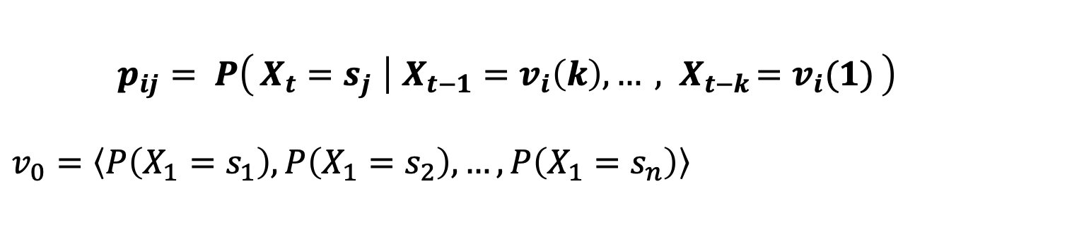
k^{th}-order Markov Chain
A k^{th}-order Markov chain is defined by the model $\left\langle S, T, v_{0}\right\rangle$ such that:
$S=\{s_{1},…, s_{n}\}$ is the set of n states
$T$is a $n^{k} × n$ matrix of transition probabilities such that:
… and let $v_{i}=⟨s^{1}, …, s^{k}⟩$
$p_{ij}= P\left(X_{t}=s_{j} ∣ X_{t−1}=v_{i}\left(k\right), …{ , X}_{t−k}=v_{i}(1)\right)$
$v_{0}=\left\langle P\left(X_{1}=s_{1}\right), P\left(X_{1}=s_{2}\right), …, P\left(X_{1}=s_{n}\right)\right\rangle$

Slide 33
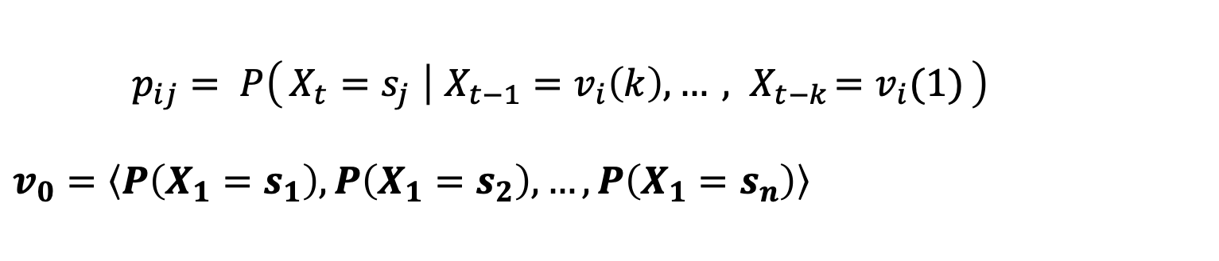
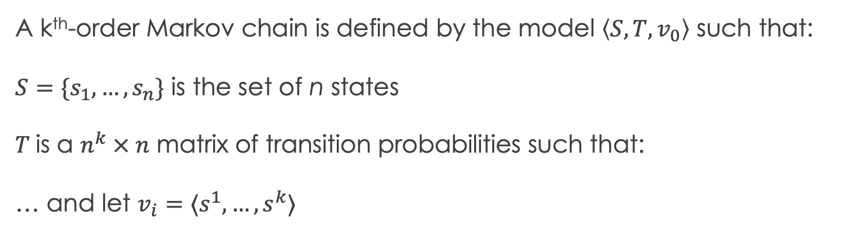
k^{th}-order Markov Chain
A k^{th}-order Markov chain is defined by the model $\left\langle S, T, v_{0}\right\rangle$ such that:
$S=\{s_{1},…, s_{n}\}$ is the set of n states
$T$is a $n^{k} × n$ matrix of transition probabilities such that:
… and let $v_{i}=⟨s^{1}, …, s^{k}⟩$
$p_{ij}= P\left(X_{t}=s_{j} ∣ X_{t−1}=v_{i}\left(k\right), …{ , X}_{t−k}=v_{i}(1)\right)$
$v_{0}=\left\langle P\left(X_{1}=s_{1}\right), P\left(X_{1}=s_{2}\right), …, P\left(X_{1}=s_{n}\right)\right\rangle$

Slide 34
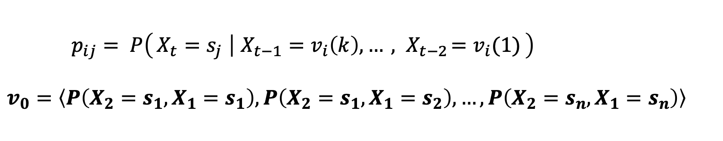
k^{th}-order Markov Chain
A k^{th}-order Markov chain is defined by the model $\left\langle S, T, v_{0}\right\rangle$ such that:
$S=\{s_{1},…, s_{n}\}$ is the set of n states
$T$is a $n^{k} × n$ matrix of transition probabilities such that:
… and let $v_{i}=⟨s^{1}, …, s^{k}⟩$
$p_{ij}= P\left(X_{t}=s_{j} ∣ X_{t−1}=v_{i}\left(k\right), …{ , X}_{t−2}=v_{i}(1)\right)$
$v_{0}=\left\langle P\left({X_{2}=s_{1}, X}_{1}=s_{1}\right), P\left({X_{2}=s_{1}, X}_{1}=s_{2}\right), …, P\left(X_{2}=s_{n}, X_{1}=s_{n}\right)\right\rangle$

Slide 35
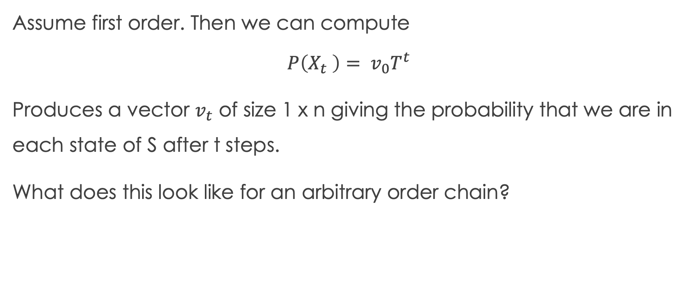
Markov Chains via Linear Algebra
Assume first order. Then we can compute
$$P\left(X_{t} \right)= v_{0}T^{t}$$
Produces a vector $v_{t}$ of size 1 x n giving the probability that we are in each state of S after t steps.
What does this look like for an arbitrary order chain?

Slide 36
First order spreadsheet demo 1

Slide 37
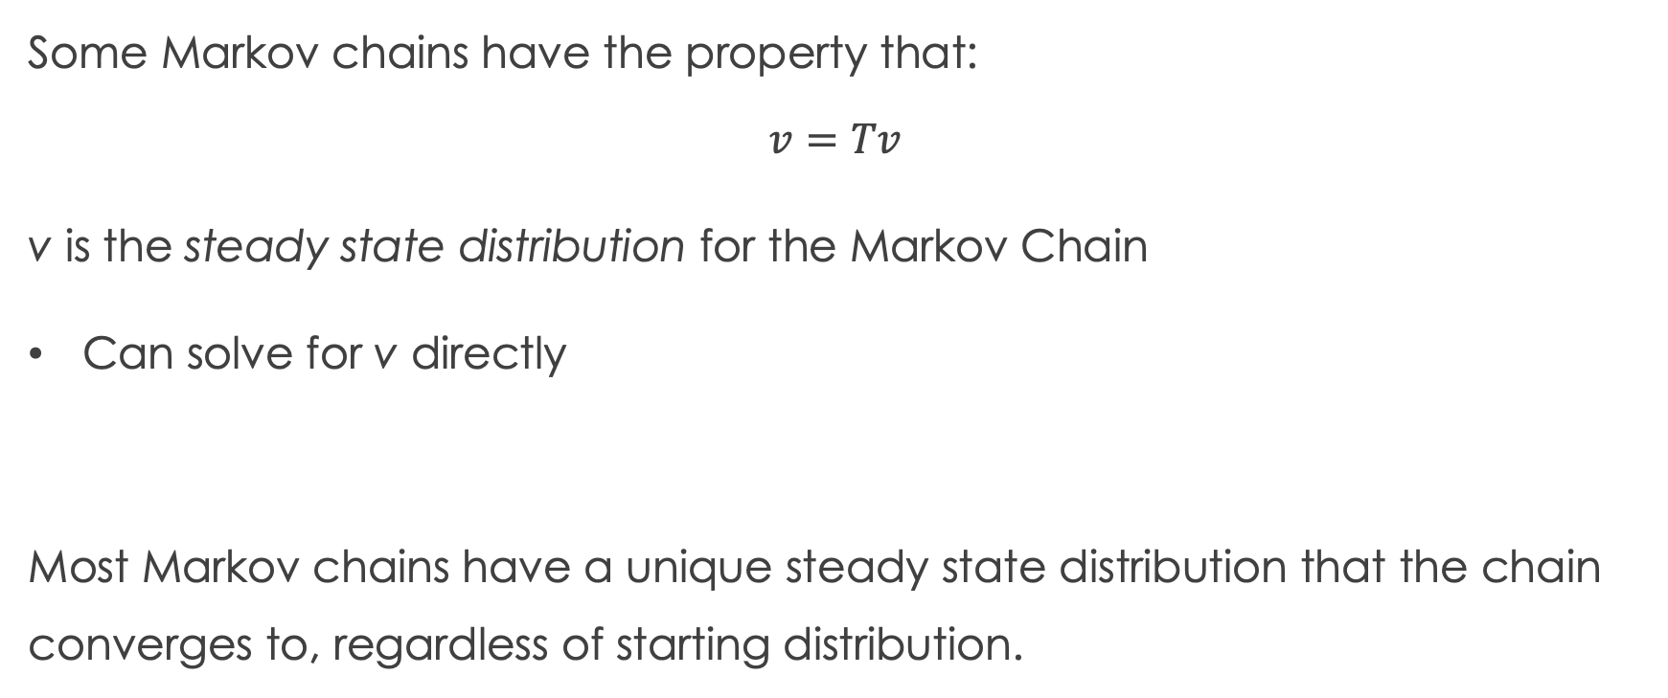
Steady State Distributions
Some Markov chains have the property that:
$$v=Tv$$
v is the steady state distribution for the Markov Chain
Can solve for v directly
Most Markov chains have a unique steady state distribution that the chain converges to, regardless of starting distribution.

Slide 38
First order spreadsheet demo 2

Slide 39
Property: Irreducibility
A Markov Chain is irreducible iff in the transition graph there exists a path from every state to every other state, i.e., you can’t get stuck in a group of nodes.

Slide 40
First order spreadsheet demo 3

Slide 41
Property: Aperiodicity
An irreducible Markov chain with transition matrix T is called periodic if there exists some t >1 such that there exists a state s which can only be visited at time steps {t, 2t, 3t, …}, that is with period t.
If T is not periodic (i.e., t=1), then the chain is aperiodic.

Slide 42
Property: Uniqueness of steady state distribution
A Markov chain that is irreducible and aperiodic has a unique steady state distribution.
This is the property that allows Markov Chain Monte Carlo sampling.

Slide 43
Markov Decision Processes (MDPs)
Markov Chains + decisions
Two new pieces of information:
Actions to take (choices/decisions)
Rewards for entering a new state due to an action

